Slide 1
Holiday Season Insights
Tyler Chiu
Data Provided by MRC Data
Notes:
Would like to showcase my thought process:
First explored the data to make sense of data fields
Visualize and question sample/population behavior

Slide 2
Overview
Holiday Music Insights:
Given that consumers are listening to holiday music within the last 20 years uniformly (refer to slide 6), I wanted to know if people are consuming this music the same across this wide time period.
Being a jazz musician, older holiday songs resonate with me because of its jazz style or influence; this motivated me to see if people consumed old and new holiday songs differently across platforms
Simply by splitting the data in half by its median (2004), I used visualizations and statistical tests to compare sales and streaming (refer to slides 10-13) , which I concluded with:
Newer albums (after 2004) sold more copies Physically and Digitally (refer to slide 14)
Older albums (before 2004) were Streamed (On-Demand/Programmed) more (refer to slide 15)
Old and new albums had similar amounts of Digital Song Sales (refer to slide 15)

Slide 3
Overview
Holiday Music Trends During Christmas Week:
During the holidays, holiday music gets the most attention, which the figures (refer to slides 14 - 19) draw attention to
Holiday music has a greater proportion of Physical and Digital Album Sales during Christmas Week (refer to top graphs of slides 18 & 19)
The total volume of holiday music and other genres have decreased in total album sales throughout the past 4 years
Other genres of music have better Digital Album Sales on Christmas day surprisingly
Other genres of music sell more digital songs during Christmas week but have had diminishing volumes of digital song sales throughout the past 4 years
A higher proportion of holiday music is being consumed on Programmed Streaming platforms due to an overall increase in programmed streaming volume (refer to slide 21)
Users listen to other genres of music with On-Demand Streaming services except for Christmas day (refer to slide 22)

Slide 4
Overview
Holiday and Other Genre Trends Throughout the Year :
Holiday Physical Album Sales have the highest proportion of sales during November and lowest in June (refer to bottom graph on slide 18)
Physical and Digital Albums Sales along with Digital Song Sales have been decreasing in general for the past 4 years from 2015-2018 (refer to table on slide 26)
Holiday Physical Albums sales have decreased by 93%
Other genres Physical Album sales have decreased by 53%
Holiday Digital Albums sales have decreased by 92%
Other genres Digital Album sales have decreased by 61%
Airplay Interaction has had consistent holiday music and other genre consumption throughout the years with only slight decrease in traffic volume (refer to slide 23)
Streaming (On-Demand/Programmed) has become a dominant force in music consumption (refer to table on slide 26)
Total On Demand streaming of other genres has increased by 264%

Slide 5
What could be driving the trends?
Streaming services are becoming more popular as music ownership declines
The shift towards streaming services (On-Demand/Programmed) can be attributed to their low cost compared to physical/digital ownership (iTunes, Amazon, etc) which is becoming less favorable or unavailable
Apple announced that on March 31, 2019, iTunes would be closing
Apple Music has had a growth rate of 2.4-2.8% compared to Spotify’s 2-2.3% (https://www.wsj.com/articles/apple-music-overtakes-spotify-in-u-s-subscribers-11554475924)
Devices capable of playing discs such as laptops and cars are being phased out, making Physical Album Sales less likely
Curated playlists are becoming major sources of how people find music, as noted by the growth in demand for playlist curators from companies like Spotify and Apple Music
http://www.thembj.org/2017/08/the-rise-of-curated-playlists/
To be discovered through playlists, artists are switching from album (LP/EP) formats to singles
https://spinnup.com/uc/blog/singles-vs-eps-whats-the-best-release-strategy/

Slide 6
What does the future look like?
We expect more people will turn to digital streaming methods for their holiday music (refer to tables on page 25-26) as overall digital streaming increases
In light of COVID-19, streaming and non ownership will be the main choice of music consumption
With government mandated stay in orders, physical ownership will continue to decline as people no longer have the option to obtain physical albums
The financial implications of the coronavirus crisis will incentivize people to turn to digital streaming/programmed streaming as a more financially savvy option
Artists such as Pentatonix, Michael Buble, and Mariah Carey will likely continue to dominate holiday charts (refer to slide 12)
As the economy recovers from the coronavirus, we hope to see people make a return to album and song ownership; but a large volume of consumers will remain loyal to their current digital subscriptions
https://www.nytimes.com/2020/04/13/business/coronavirus-economy.html

Slide 7
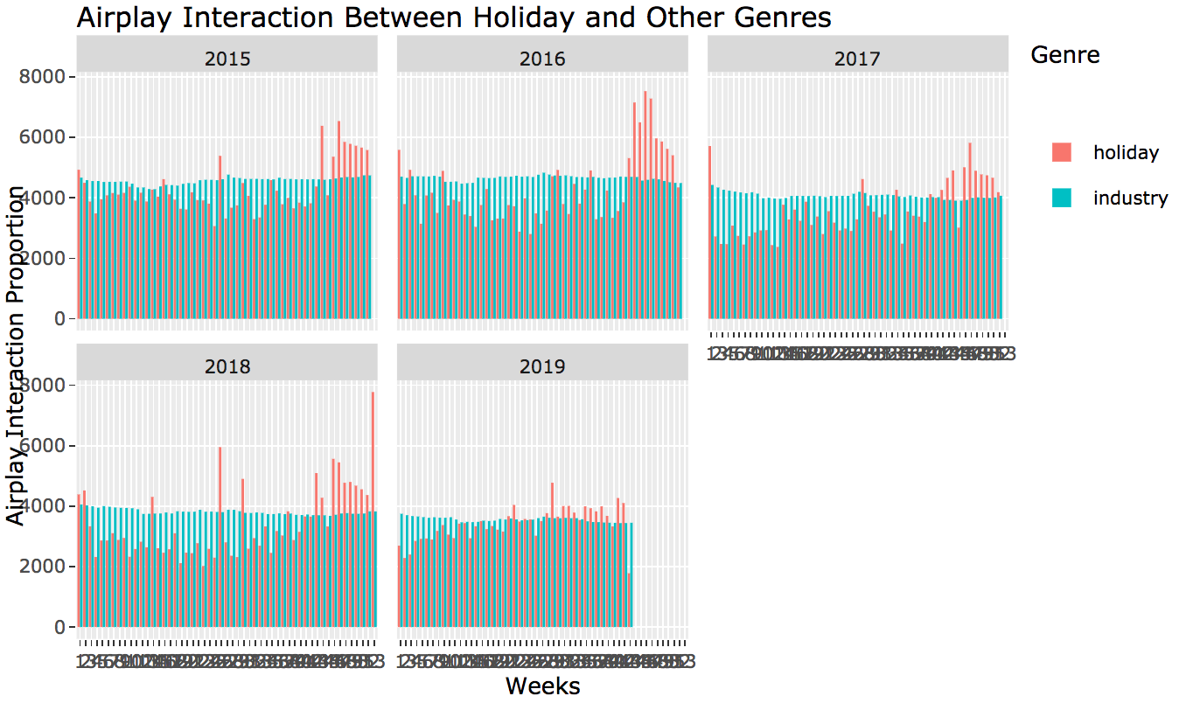
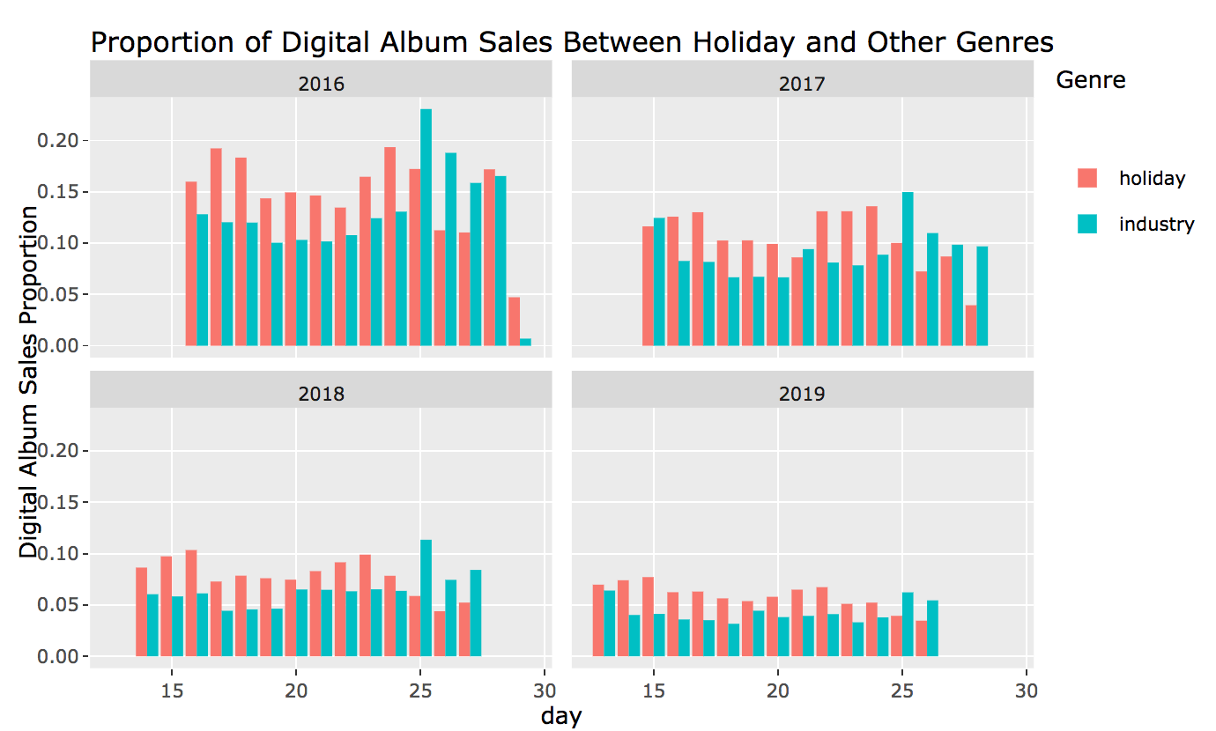
Are there any anomalies in the data?
In June on week 26, there is a random spike
that occurs (graphs are interactive in html file)
Why is there an increase in the
summer?
On Christmas Day, other digital albums
from other genres of music are
purchased more, otherwise,
digital holiday albums are
purchased more
The spike in other album sales can be
attributed to gifts and increase
In disposable income

Slide 8
Reflections
With this presentation, I drew upon my programming and statistical skills to produce visualizations, tables, and feature engineering
Would love to have an opportunity to have more freedom with my findings and deploy statistical models to make predictions
Due to lack of data and amount of uncertainty due to the current climate, I chose to analyze the current trends without relying on predictive models
The structure of the presentation and appendix reflect my thought process of exploring data visually and tabularly before running statistical methods
This was a very inspiring and exciting project given the data and a topic that was relevant to my artistic and academic endeavors

Slide 9
Appendix
Collected works of graphs, statistical methods,tables, and explanations of the trends
(interactive graphs are in mrc data.html)

Slide 10
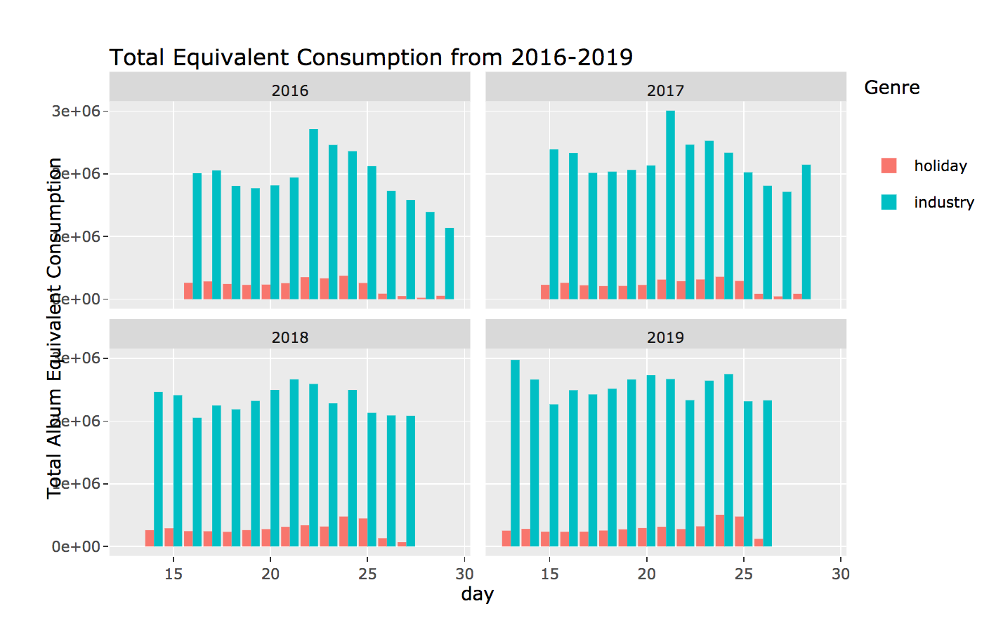
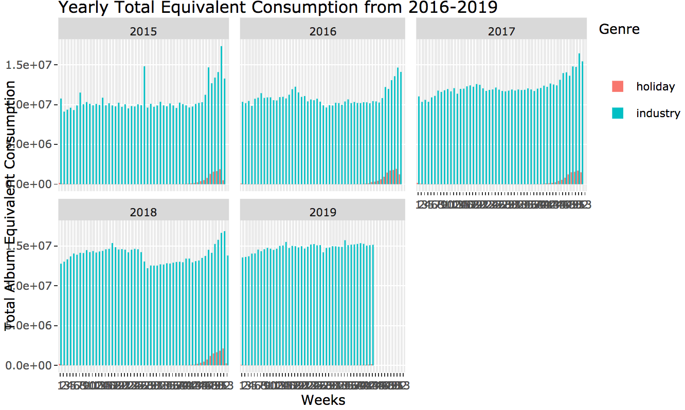
Anecdote
The volume of the rest of the music industry album sales is enormous compared to the small volume of holiday album sales
By dividing total album equivalent with respect to holiday and other genres of music, we can see the different ways consumers are listening to music
Notes:
The volume of the rest of the music industry album sales is enormous compared to the small volume of holiday album sales
By dividing by the respect total album equivalent, we can see how consumers are consuming their music
Left figure refers to the total album equivalent consumption during each day of Christmas week from 2016 - 2019
Right figure refers to the total album equivalent consumption during each week of the entire year from 2016 - 2019
Needed to account for disproportionate availability of holiday music compared to other genres by dividing by Total Album Equivalent Consumption in later visualizations

Slide 11
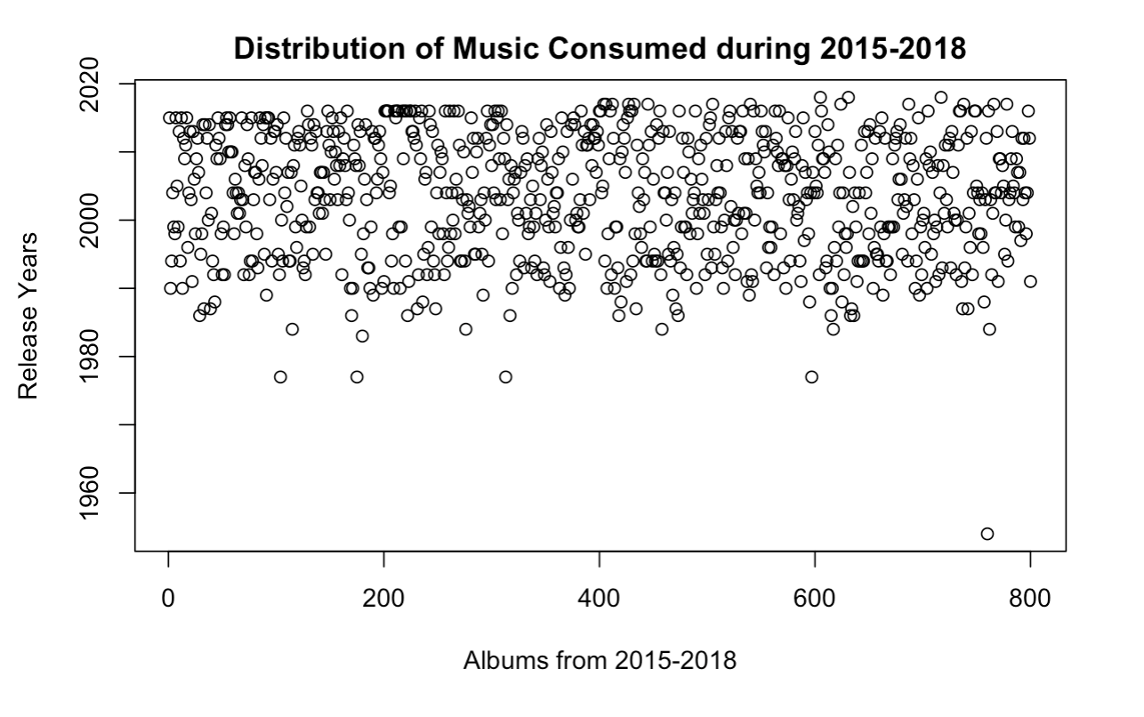
How is holiday music trending?
What music is being listened to?
For the past 4 years, people have been mainly listening to holiday songs that have been produced in the last 20 years
There is a uniform distribution of music listening across these 20 years in data from 2015 - 2018

Slide 12
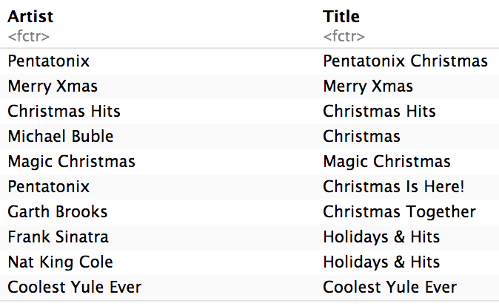
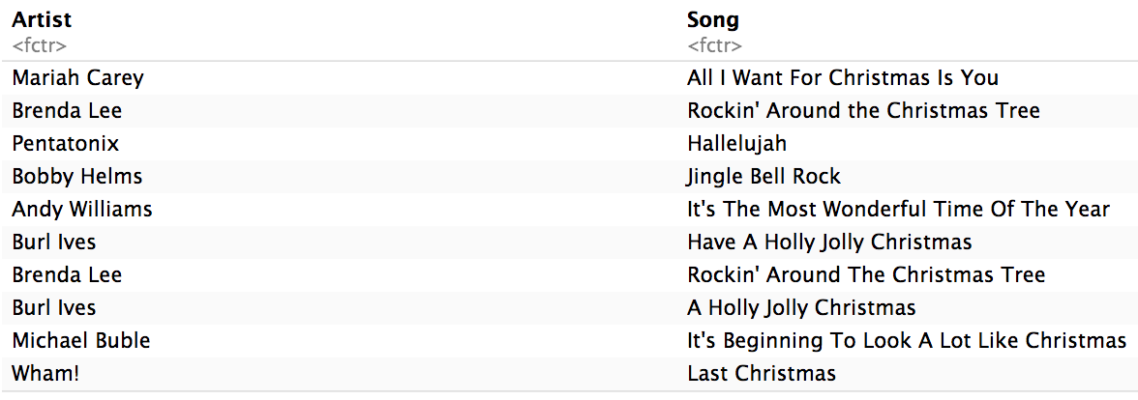
How is holiday music trending?
Which artists have been trending for the past 4 years?
The top holiday albums with highest
ranking given by TAEC from 2015-2018:
The top songs with highest rank and
longest weeks on the chart from 2015-2018:
Notes:
The distinction in the artists between top ranking albums vs songs can illuminate differences in how people interact with these differents sets of artists.
The distinction between artists lies in the genre and time period of the artists
The artists in the top album list are more from jazz influences whereas the top songs have artists with more pop and country backgrounds

Slide 13

How has holiday music been trending?
Are there different consumer behaviors between older and newer holiday music? (old = before 2004, current = after 2004; based on median)
Are people listening to older music on different platforms compared to new music?
Are people choosing to buy new music from newer artists more so than older music?
Notes:
Being a jazz musician, I was curious about how older artists stemming from jazz eras/influences are currently doing
Decided to split the data between 2004 because it was the median

Slide 14
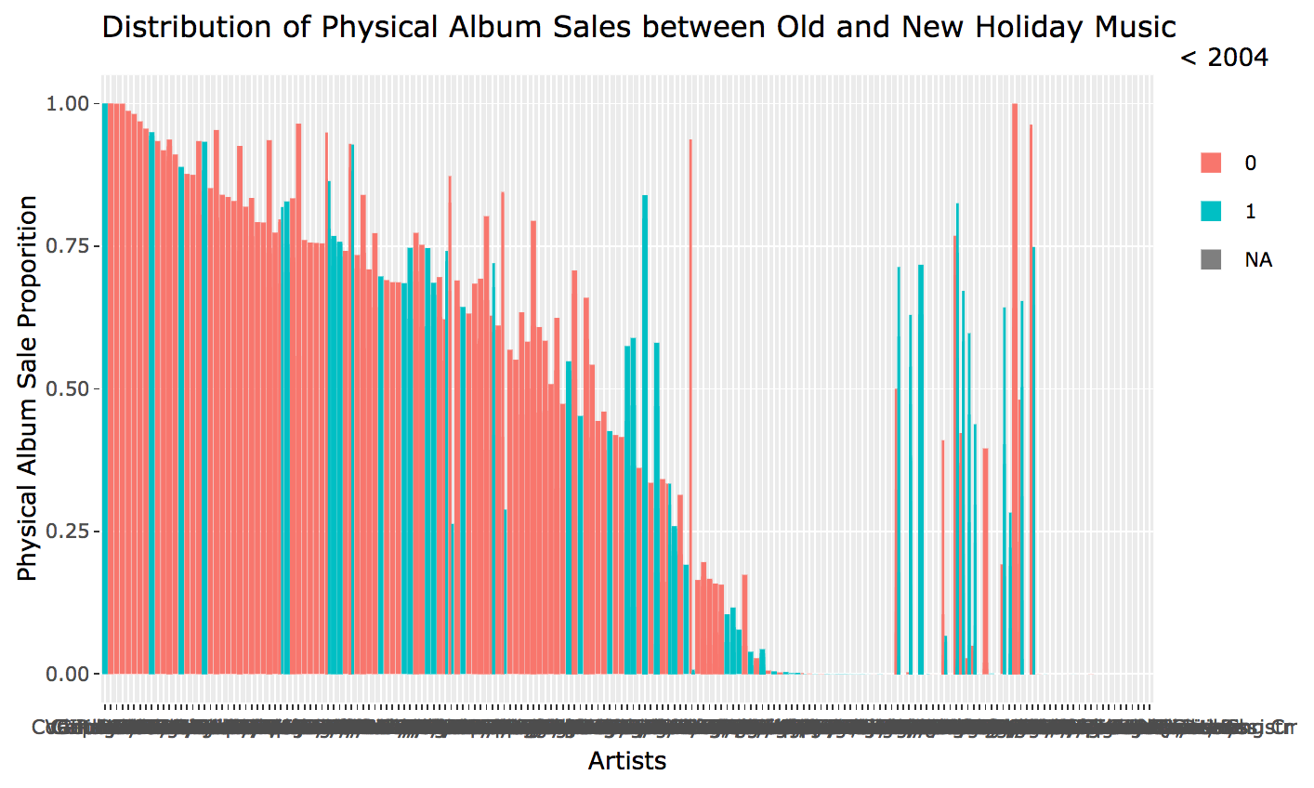
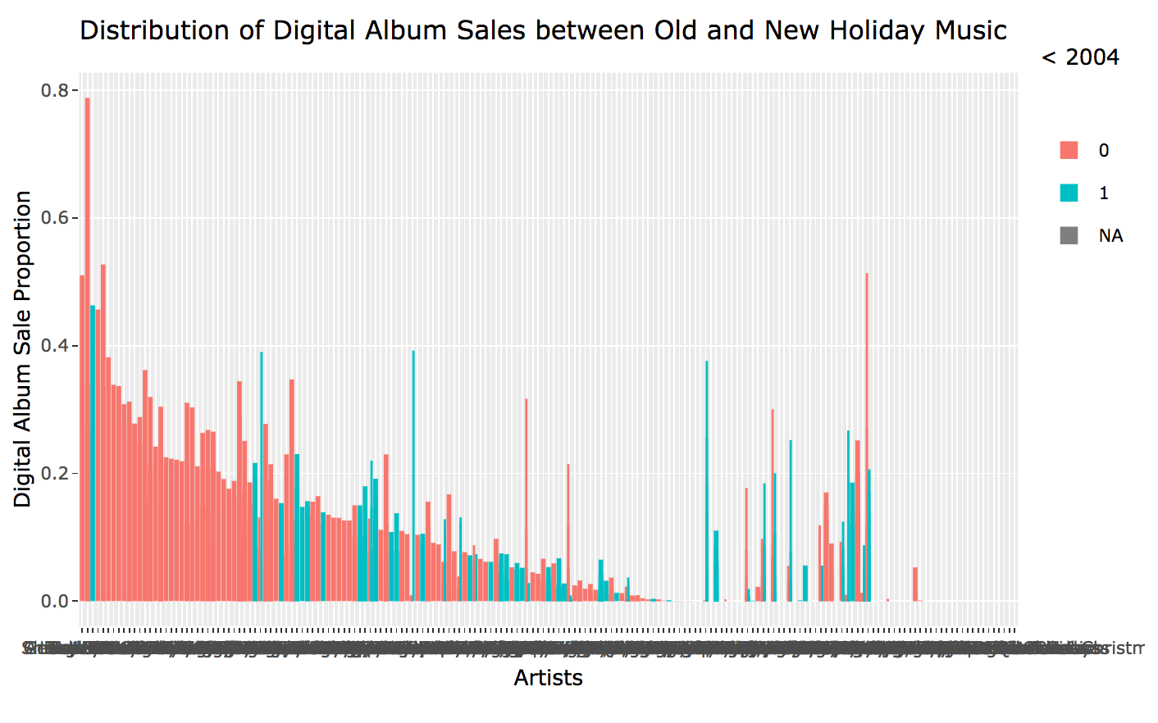
Consumer behavior between Physical and Digital Album sales
Red = new music (after 2004), Blue = old music (before 2004)
Notes:
0 is new music, 1 is old music
Plots show distribution of album sales with highest number of sales on the left
Disclaimer: the spike on the right was some unavoidable formatting issue
Physical Album Sale: aside from chipmunks that is from before 2004, the highest physical album sales are from albums after 2004
Digital Album Sale: More albums from after 2004 are being purchased
On Demand: More older artists are being listened to on streaming

Slide 15
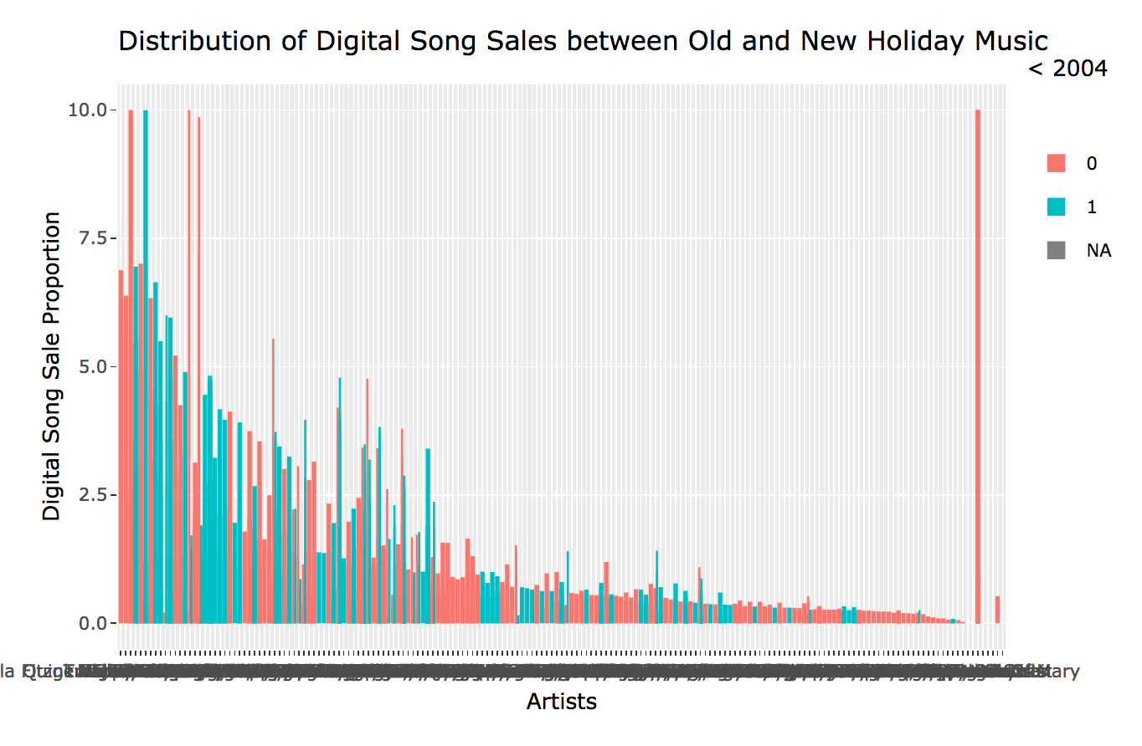
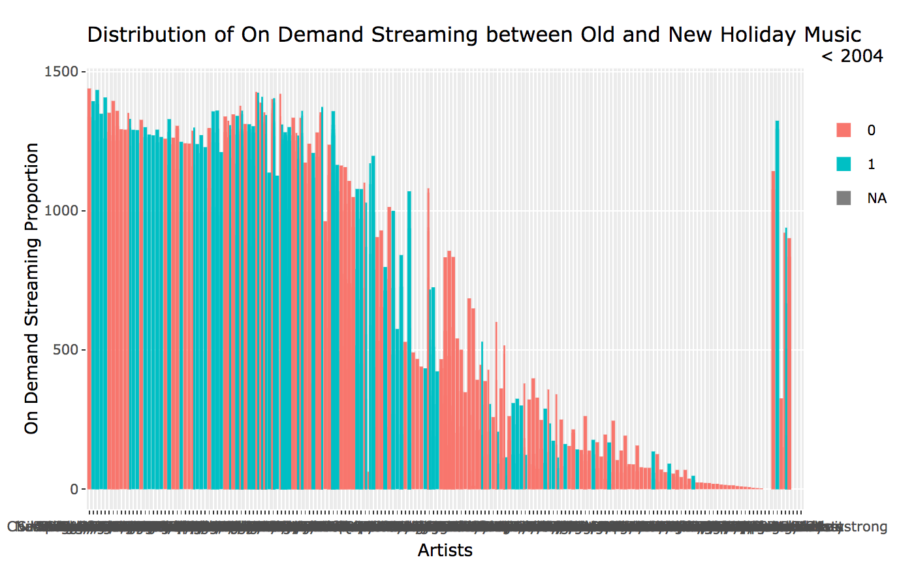
Consumer behavior for digital song sales and on demand streaming
Red = new music (after 2004), Blue = old music (before 2004)
Notes:
Digital song sales: no significant difference
Streaming: Older music is streamed more

Slide 16
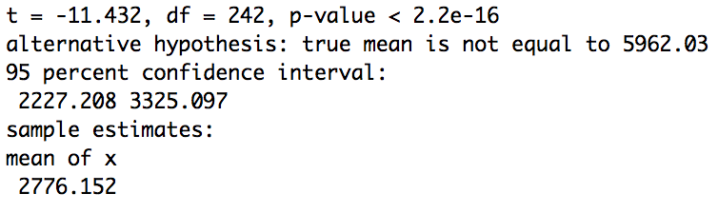
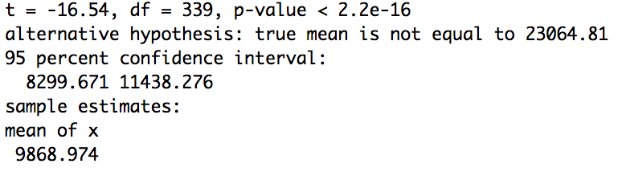
Statistical Tests
One sample t test between Digital Album Sales from before and after 2004
P-value <.05, so we reject the notion that Digital Album sales are the same across old and new music
One sample t test between Physical Album Sales from before and after 2004
P-value <.05, so we reject the notion that Physical Album sales are the same across old and new music

Slide 17
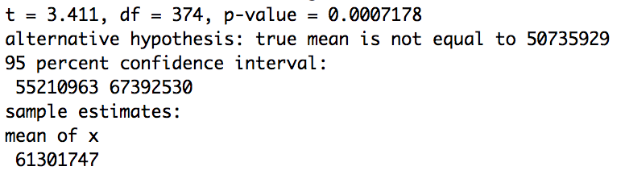
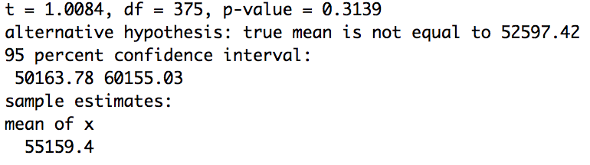
Statistical Tests
One sample t test between On Demand Streaming from before and after 2004
P-value <.05, so we reject the notion that On Demand Streaming are the same across old and new music
One sample t test between Digital Song Sales from before and after 2004 (no difference)
P-value >.05, so we do not reject the notion that Digital Album sales are the same across old and new music

Slide 18
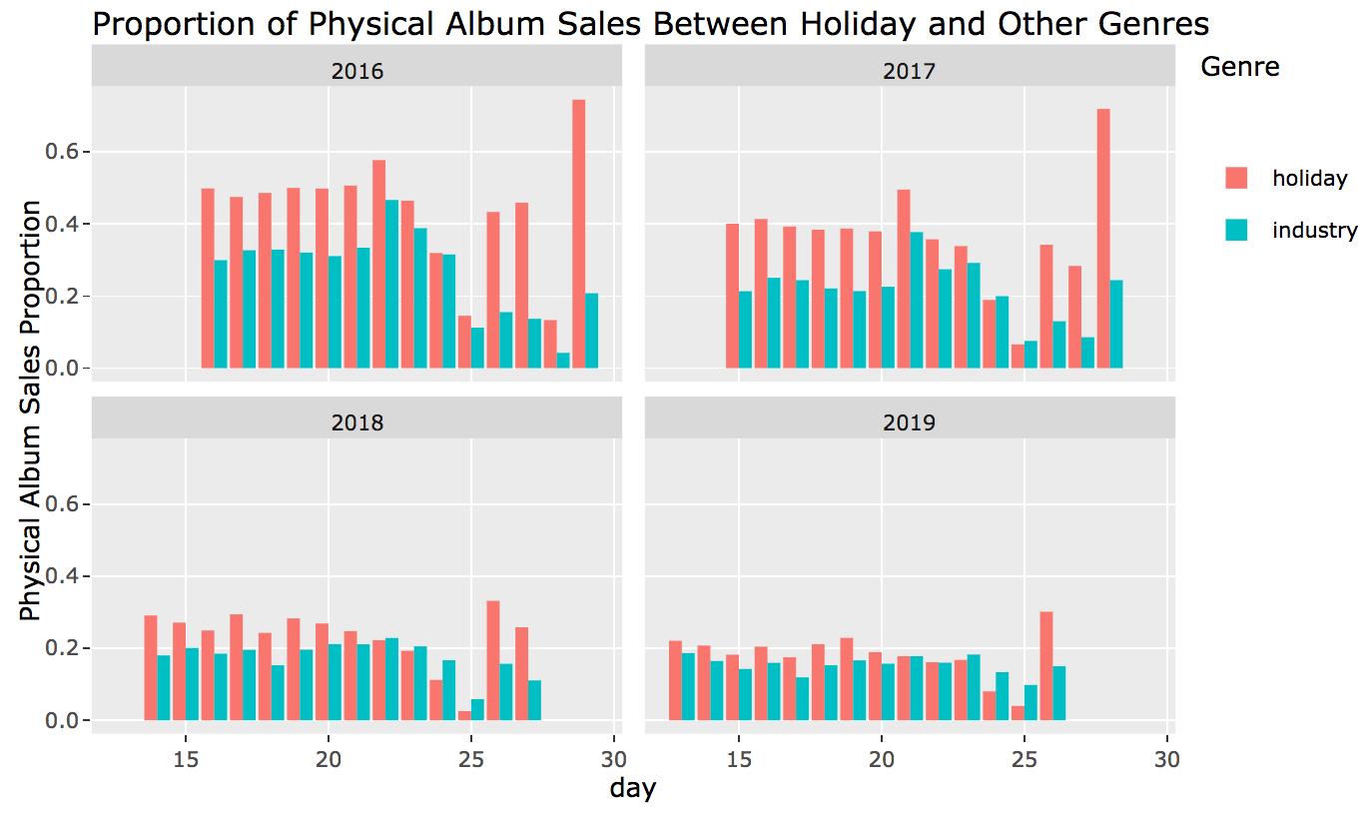
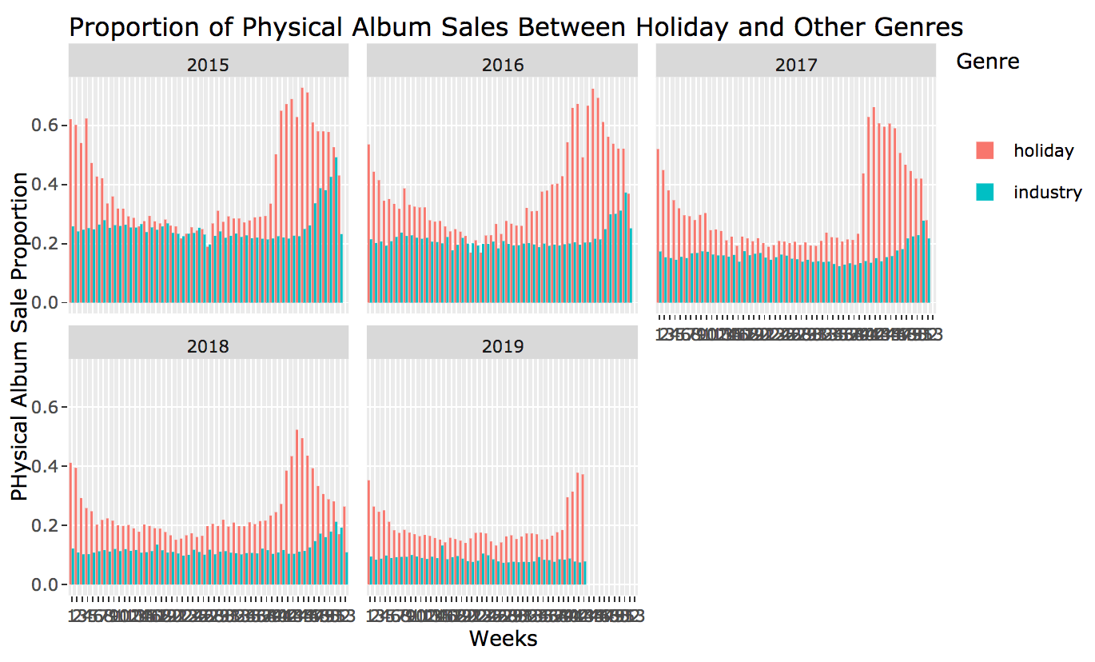
What do holiday trends look like compared to the industry as a whole?
Physical Album sales during Christmas Week
Physical holiday albums are purchased in
greater proportion than other genres
during xmas week
Decline in sales volume for past 4 years
Physical Album sales throughout the year
Holiday Physical Album sales hit a minimum
around week 20, which is June. holiday
physical album sales hit its max at week 40,
which is in november
Notes:
Be clear to describe that the data has been standardized so that sales are in proportion to the availability of the album
Disclaimer: the bottom set of graphs is very sensitive to the variance in holiday physical album sales so appears

Slide 19
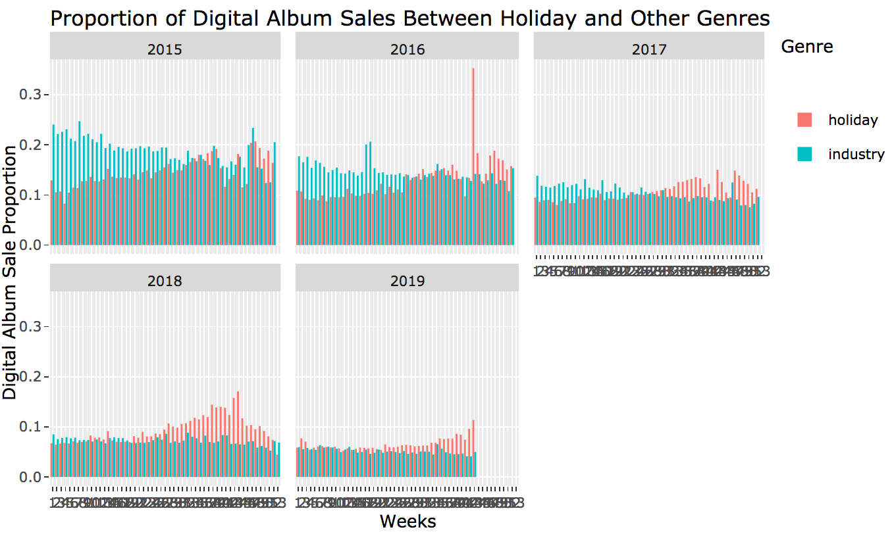
What do holiday trends look like compared to the industry as a whole?
Digital Album Sales during Christmas week
Digital holiday albums are bought more during
Christmas week except for Christmas day
(easier to see in codebook)
Why is there a spike of other genre
album sales on Christmas day?
Digital Album Sales throughout the year
Peak of holiday digital album
sales occurs around week 43 which is mid october
Decrease in digital album ownership over the past 4 years

Slide 20
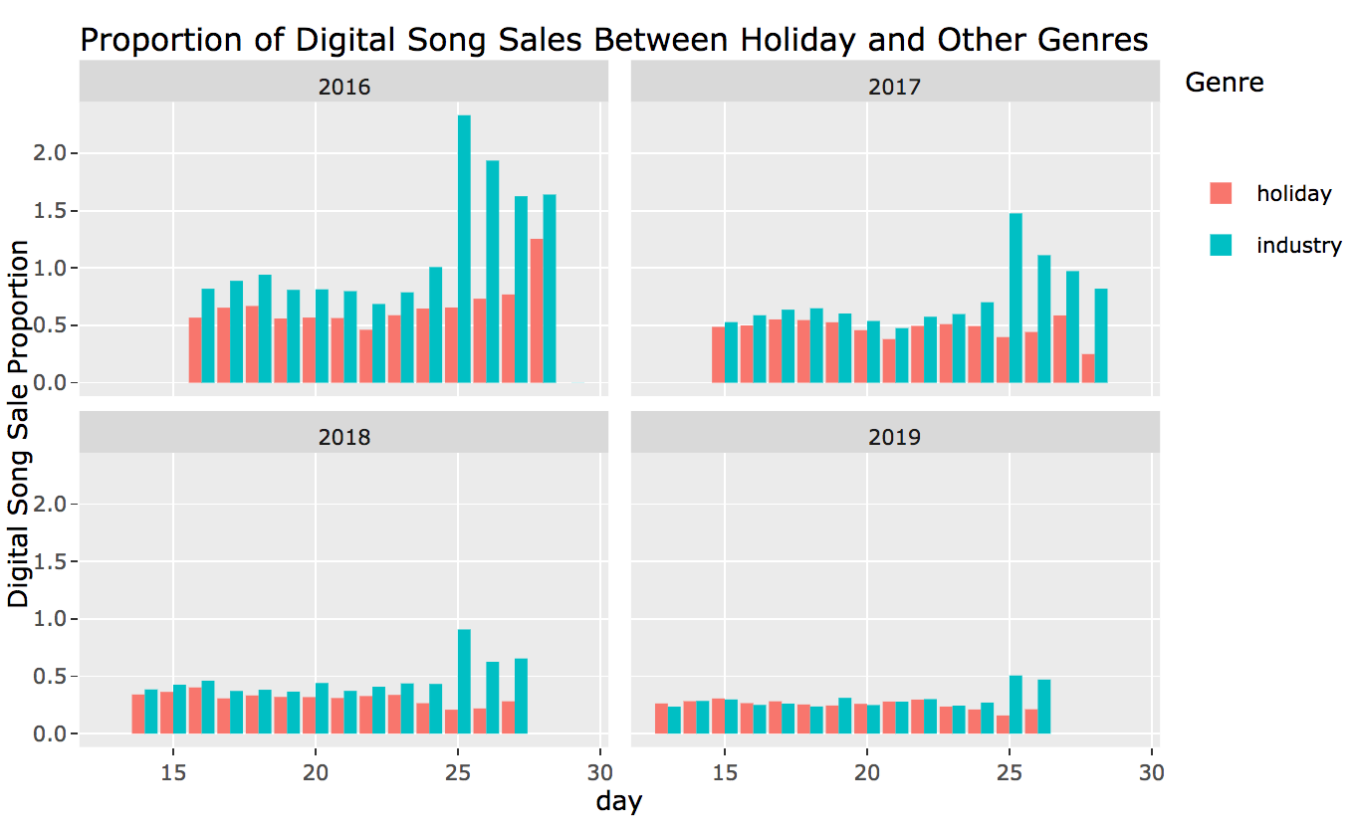
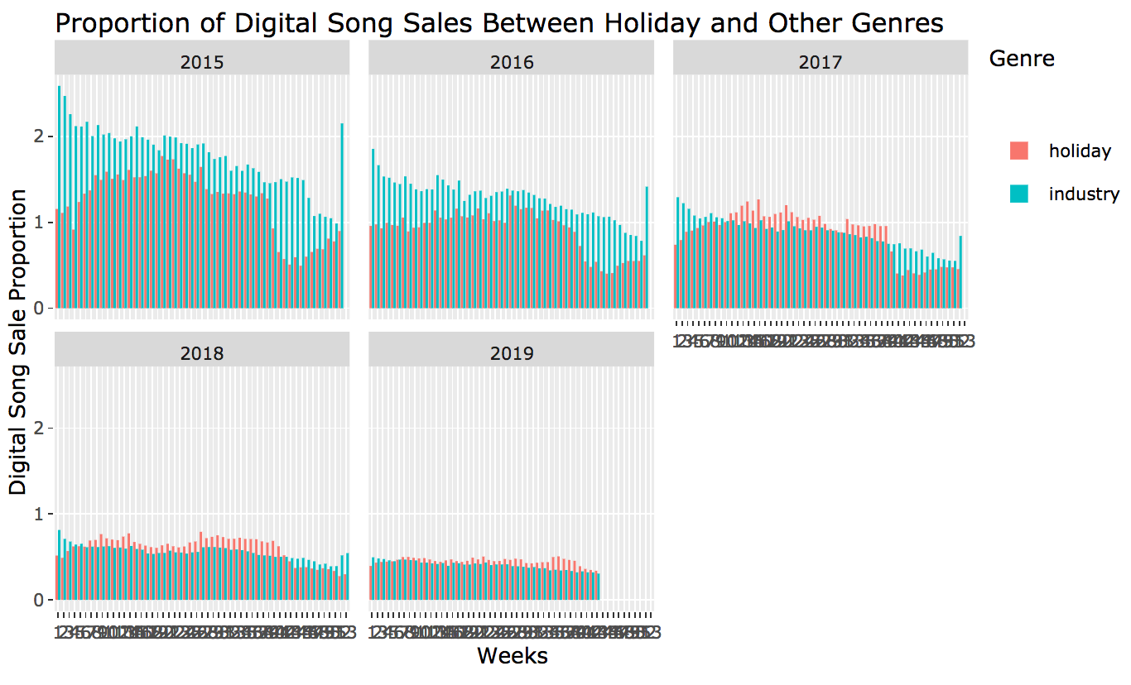
What do holiday trends look like compared to the industry as a whole?
Digital Song sales during Christmas week
Individual song sales are more prevalent
in other genres with a spike in sales
after Christmas
Overall decline in song sales
Digital Song sales throughout the year
There is an overall decline in individual digital
song sales across the years. Holiday digital
song sales trends follows streaming on
demand patterns
There is a dip in holiday song sales during the
Month of October
Peak in holiday song sales during May

Slide 21
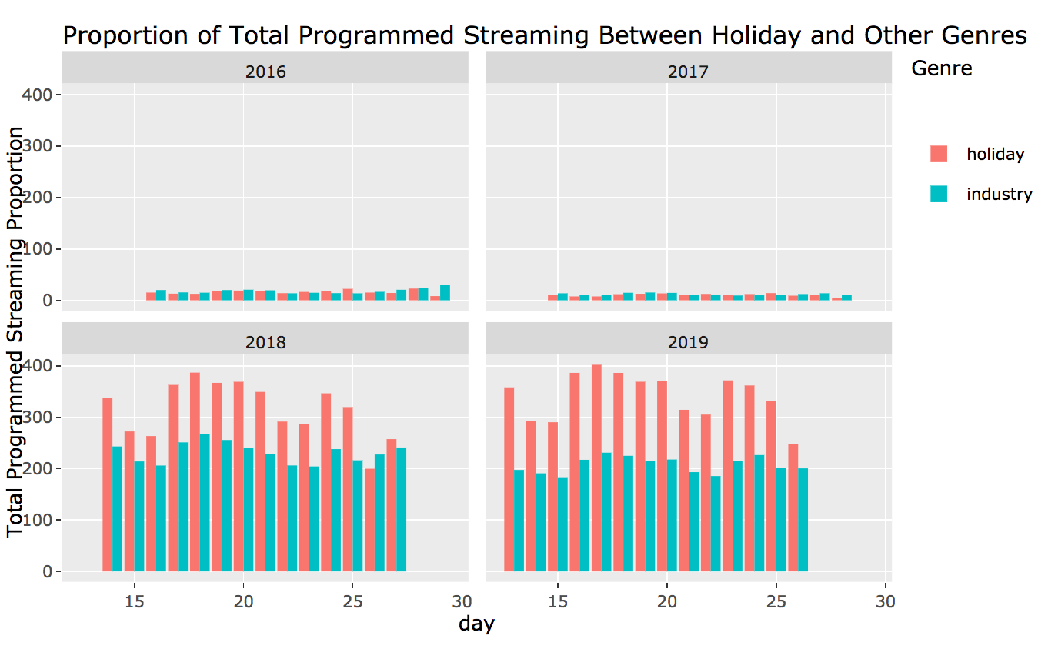
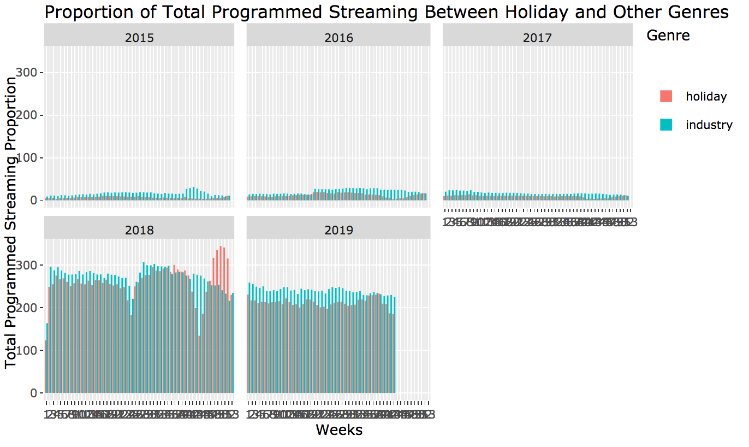
What do holiday trends look like compared to the industry as a whole?
Total programmed streaming during Christmas Week
Holiday music is listened more frequently
Significant growth in programmed streaming
volume for both categories
Total programmed streaming throughout the year
Programmed streaming is gaining popularity
independent of music genre
Notes:
Total streaming: other genres of music have a higher rate of streaming during the holidays
Total Programmed Streaming: there has been an increase in programmed streaming in the past 4 years. Holiday music was streamed more frequently than other genres during the holiday season when controlled by the proportion of albums across different genres.
Airplay: when holiday music is being streamed on the radio, it is more listened to than other genres

Slide 22
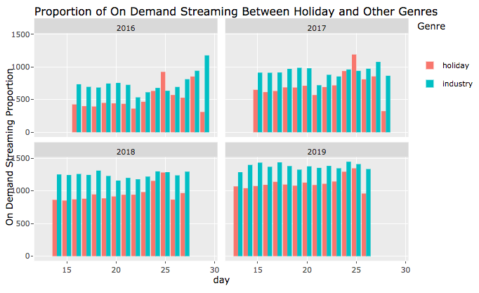
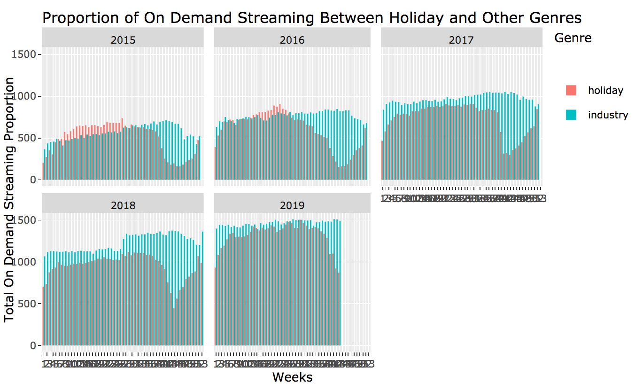
What do holiday trends look like compared to the industry as a whole?
On demand streaming during Christmas Week
People are streaming other genres more
Except on Christmas eve
The volume of streaming during xmas week
Is increasing
On demand streaming throughout the year
on average, other genres of music are
streamed more than holiday music.
Holiday music streaming begins decreasing
around week 35 plus or minus 3 weeks which
is around late August
The volume of streaming in general is increasing

Slide 23
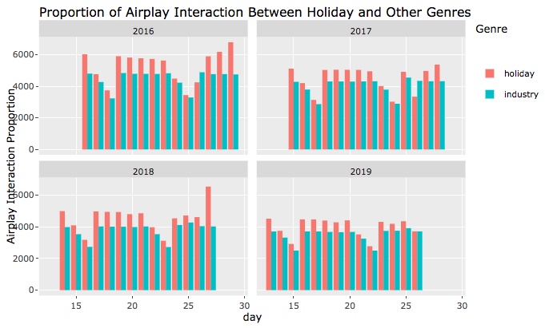
What do holiday trends look like compared to the industry as a whole?
Airplay Interaction during Christmas Week
Holiday music is listened to more
during xmas week
Slight decline in holiday radio
consumption over the years
Airplay Interaction throughout the year
Holiday music is listened to more
during xmas week
Slight decline in radio consumption
in general over the years

Slide 24
Trend Figures
There is a huge growth in digital platforms (On Demand, Streaming, Programmed) and significantly diminished volume of holiday album sales during the holiday season
Holiday Album % Change from 2015-2018
Generated from Annual Holiday Album Ranked List
Total Album Equivalent Consumption | Album Sales | Physical Albums Sales | Digital Albums Sales | Digital Song Sales | Streaming On Demand Audio
248.82267 | -42.30580 | -40.09810 | -24.30441 | -34.80904 | 973.27489
Notes:
Purpose is to show the volume % changes in the top holiday album list over the years from 2015-2018

Slide 25
Trend Figures
Holiday album trends during Christmas week in % change from 2015-2018
Other genre album trends during Christmas in % change from 2015-2018
Total Album Equivalent Consumption | Total Album Equiv Con - Audio | Albums w/TEA | Total Album Sales | Physical Album Sales | Digital Album Sales | Digital Song Sales
34.49 | 41.94 | -50.83 | -50.93 | -50.83s | -51.21 | -43.87
Total Streaming on Demand | Streaming on Demand Audio | Streaming On Demand Video | Total Streaming Programmed | Streaming Programmed Audio | Streaming Programmed Video | Airplay Spins | Airplay Audience
209.84 | 271.99 | 95.67 | 2732.82 | 2733 | -100 | 45.6 | 19.47
Total Album Equivalent Consumption | Total Album Equiv Cons - Audio | Albums w/TEA | Total Album Sales | Physical Album Sales | Digital Album Sales | Digital Song Sales
33.04 | 42.65 | -42.03 | -36.489 | -27.5 | -56.12 | -63.34
Total Streaming on Demand | Streaming on Demand Audio | Streaming On Demand Video | Total Streaming Programmed | Streaming Programmed Audio | Streaming Programmed Video | Airplay Spins | Airplay Audience
154.83 | 171.32 | 129.57 | 1466.22 | 1466.37 | -100 | 17.25 | -8.81
Notes:
Purpose is to contrast volume changes between holiday albums and other genre albums during Christmas week from 2015-2018

Slide 26
Trend Figures
Year round trends:
Holiday music throughout the year in % change from 2015-2018
Other genres throughout the year in % change from 2015-2018
Total Album Equivalent Consumption | Total Album Equiv Con - Audio | Albums w/TEA | Total Album Sales | Physical Album Sales | Digital Album Sales | Digital Song Sales
-82.9 | -84.03 | -92.77 | -93 | -93 | -92 | -90
Total Streaming on Demand | Streaming on Demand Audio | Streaming On Demand Video | Total Streaming Programmed | Streaming Programmed Audio | Streaming Programmed Video | Airplay Spins | Airplay Audience
-24.14 | -18.33 | -30.27 | 503.7 | 503.78 | -100 | -98.15 | -98.95
Total Album Equ Consumption | Total Album Equiv Con - Audio | Albums w/TEA | Total Album Sales | Physical Album Sales | Digital Album Sales | Digital Song Sales
39.96 | 51.62 | -59.8 | -56.7 | -53.33 | -61 | -67.83
Total Streaming on Demand | Streaming on Demand Audio | Streaming On Demand Video | Total Streaming Programmed | Streaming Programmed Audio | Streaming Programmed Video | Airplay Spins | Airplay Audience
264.1 | 415.13 | 135.16 | 2022.14 | 2022.67 | -100 | 25.71 | -2.18
Notes:
Purpose is to show volume changes between holiday and other genre albums throughout the entire year from 2015-2019

